Slide 1
Chapter 7:
The Queue Abstract Data Type
Data Structures in Java: From Abstract Data Types to the Java Collections Framework
by Simon Gray

Slide 2
Introduction
Examples of Queue usage:
  Operating systems schedulers: processes can be placed in a ready queue awaiting their turn to use the processor
  Print spoolers: print jobs on a first-come-first-served basis
  Simulations of any queue-like behavior (e.g., planes on a runway, customers in a checkout line)
  Network packet buffering: packets arriving on the input port of a router will be queued up on one of the router’s output port for the next hop
Queue: a First-In-First-Out (FIFO) data structure – the first item into the queue is the first out of it
  Attributes:
    front – the next element to remove from the queue
    rear – position where next element is to be inserted into the queue
  Operations: enqueue(element), dequeue(), peek(), isEmpty(), size()
7-<number>

Slide 3
Queue Properties and Attributes
Properties
Queues are FIFO data structures. All insertions are done at the rear and all deletions at the front
The front always refers to the first element in the queue
The rear always refers to the position where the next element is to be inserted in the queue
The queue has a fixed upper bound (capacity) on the number of elements it can store
A Queue could be “boundless”. An upper bound is used to
illustrate the issues it raises, such as need for more attributes
Attributes
capacity : The maximum number of elements that can be in the queue at one time.
size : The number of elements in the queue: 0 ≤ size ≤ capacity at all times
front : The first element of the queue or a null value not part of the queue when the queue is empty
rear : The position in the queue where the next element is to be inserted or a null value not part of the queue if the queue is full
7-<number>

Slide 4
Queue Operations
Note the change needed to
accommodate an upper bound
on the collection’s capacity
Queue()
pre-condition: none
responsibilities: constructor - initialize the queue attributes
post-condition: size is set to 0
capacity is set to DEFAULT_CAPACITY
front refers to a null value (a special value not part of the queue)
rear refers the position where the first insertion is to be made
returns: nothing
Queue( int maxElements )
pre-condition: maxElements > 0
responsibilities: constructor — initialize the queue attributes
post-condition: size is set to 0
capacity is set to maxElements
front refers to a null value
rear refers to the position where the first insertion is to be made
returns: nothing
throws: invalid argument exception if pre-condition is not met
7-<number>

Slide 5
Queue Operations
Note the change needed to
accommodate an upper bound
on the collection’s capacity
enqueue( Type element )
pre-condition: isFull() is false
responsibilities: insert element at the rear of the queue
post-condition: element is placed at the rear of the queue
size is incremented by 1
rear is advanced to the position where the next element will be inserted or
some null value if the queue is full
returns: nothing
throws: full queue exception if pre-condition is not met
7-<number>

Slide 6
Queue Operations
dequeue()
pre-condition: isEmpty() is false
responsibilities: remove and return the element at front
post-condition: the front element is no longer in the queue
size is decremented by 1
front refers to the element that followed the previous front element or null if the queue is empty
returns: the element removed
throws: empty queue exception if pre-condition is not met
7-<number>

Slide 7
Behavior of Queue’s operations
Method | Purpose | New Object State | Returned Value
Queue<String> q = new LinkedQueue<String>() | Create an empty Queue q | capacity = 5 size = 0 front = null rear = 1st queue slot | a LinkedQueue object for Strings using the default capacity
q.enqueue (“A”) | Add “A” to q; add an element to an empty queue | size = 1 “A” front rear = 2nd queue slot
q. enqueue (“B”) | Add “B” to q; add an element to a non-empty queue | size = 2 “A” “B” front = “A” rear = 3rd queue slot
q.isFull() | See if q is full |  | false
q. enqueue (“C”) | Add “C” to q | size = 3 “A” “B” “C” front = “A” rear = 4th queue slot
String str = q.peek() | Peek at the front element of q |  | “A”
str = q.dequeue() | Delete the front element from q | size = 2 “B” “C” front = “B” rear = 3rd queue slot | “A”
q.isEmpty() | See if q is empty |  | false
str = q.dequeue () | Delete front element from q | size = 1 “C” front = “C” rear = 2nd queue slot | “B”
str = q.dequeue () | Delete front element from q | size = 0 front = null rear = 1st queue slot | “C”
q.isEmpty() | See if q is empty |  | true
str = q.peek() | Peek at the front element of q |  | empty queue exception
7-<number>

Slide 8
Designing a Test Plan
The usual suspects:
  correct instantiation
  accessor methods return the correct values
  insertions really do insertions and in the right place
  deletions really do deletions and return the correct element
What does having an upper bound on size add?
  verify that there is no problem inserting and accessing elements up to the queue’s capacity, paying special attention to when the queue is at its capacity and when it is one element short of capacity
  verify that an attempt to insert into a full queue generates the expected error
7-<number>

Slide 9
Test Case 7.1: Enqueueing to capacity
Method | Purpose | Object State | Expected Result
Queue<String> q = new LinkedQueue<String>(3) | Create an empty Queue with a fixed capacity | capacity = 3 size = 0 front = null rear = 1st queue slot | a LinkedQueue object for Strings with a capacity of 3
q.enqueue(“A”) | Enqueue into empty queue | size = 1 “A” front = “A” rear = 2nd queue slot
q.enqueue(“B”) | Enqueue into a nonempty queue | size = 2 “A” “B” front = “A” rear = 3rd queue slot
q.enqueue(“C”) | Enqueue into a nonempty queue and reach the queue’s capacity | size = 3 “A” “B” “C” front = “A” rear = undefined
q.size() | Verify queue state |  | 3
q.isEmpty() | Verify queue state |  | false
q.isFull() | Verify queue state |  | true
q.peek() | Verify queue state |  | “A”
q.enqueue(“oops”) | Verify test for pre-condition for enqueue() |  | full queue exception
7-<number>

Slide 10
ListQueue: Applying the Adapter Pattern
Tasks to complete to implement a Queue using a List
as the backing store:
Choose which implementation of List is most appropriate for representing Queue
Decide which attributes from List will play the roles of the Queue attributes
Select methods from List that will provide the behavior needed for the Queue API
Deciding how to support Queue behavior or attributes not supported by List
Define the exception classes FullQueueException and EmptyQueueException
7-<number>

Slide 11
Choose the List Implementation to use
What are the salient characteristics of a Queue?
  It is a linear structure that is accessed at both ends
What are the salient characteristics of the List implementations?
  ArrayList – accesses at index 0 are expensive while accesses at length are cheap – O(1)
  LinkedList – accesses at either end are O(1) so long as it is doubly-linked and we maintain a reference to the head and tail of the list
LinkedList wins!
7-<number>

Slide 12
Map Queue Attributes to List Attributes and/or Methods
Queue Attribute | List Attribute or Method
size | size()
front | head – position 0 of the list
rear | tail – position size() of the list
capacity | none
What are we going
to do about this?
7-<number>

Slide 13
Map Queue Methods to List Methods
Queue Operation | List Operation
void enqueue( element ) | void add( list.size(), element )
E dequeue() | E remove( 0 )
E front() | E get( 0 )
int size() | int size()
boolean isEmpty() | boolean isEmpty()
void clear() | void clear()
boolean isFull() | none
capacity() | none
What are we going
to do about this?
7-<number>

Slide 14
Providing for Queue Characteristics Not Supported by List Characteristics
List has no support built in for handling an upper bound on the number of elements that can be in a collection
The ListQueue implementation will have to manage this itself
7-<number>

Slide 15
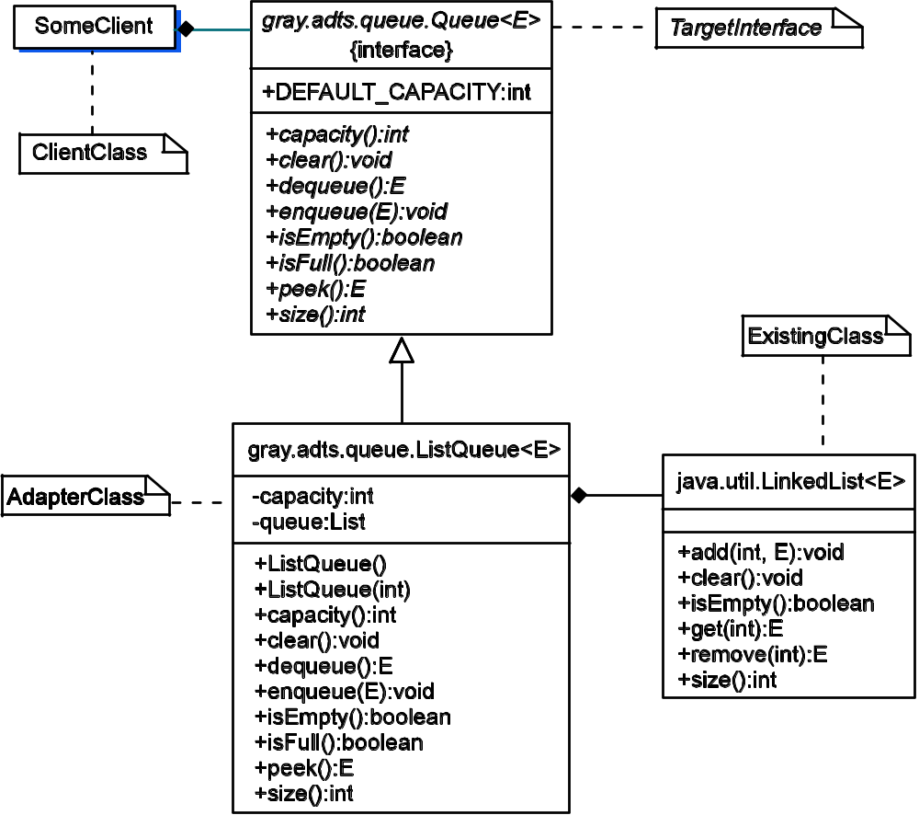
ListQueue: The UML Diagram
Compare this to the UML diagram
for the Adapter Design Pattern
7-<number>

Slide 16
What does the implementation look like?
1 package gray.adts.queue;
2
3 import java.util.LinkedList;
4 import java.util.List;
5 import java.lang.IllegalArgumentException;
6
7 /**
8 * Queue ADT implemented using the Adapter design pattern and
9 * java.util.LinkedList as the storage data structure. This
10 * version of Queue assumes an upper bound on the number of
11 * elements that can be stored in the queue.
12 */
13 public class ListQueue<E> implements Queue<E> {
14 private List<E> queue;
15 private int capacity;
16
17 /**
18 * Default constructor. Create an empty queue with the
19 * default capacity.
20 */
21 public ListQueue() {
22 this( DEFAULT_CAPACITY );
23 }
Let’s focus on aspects
relating to enforcing an
upper bound on size
7-<number>

Slide 17
What does the implementation look like?
Focus on enforcing an upper bound on size
67 /**
68 * Add <tt>element</tt> to the end of the queue.
69 * @throws FullQueueException if the queue is full
70 */
71 public void enqueue(E element) {
72 if ( this.isFull() ) {
73 throw new FullQueueException("The queue is full");
74 }
75 this.queue.add(this.queue.size(), element);
76 }
100 /**
101 * Determine if this queue has room for more elements.
102 * @return <tt>true</tt> if this queue has room for more elements
103 * (<tt>size() == capacity()</tt>); <tt>false</tt> otherwise.
104 */
105 public boolean isFull() {
106 return this.queue.size() == this.capacity;
107 }
7-<number>

Slide 18
Define Custom Exception Classes
Make it an unchecked
exception
1 package gray.adts.queue;
2
3 /**
4 * Thrown when there is an attempt to access the front
5 * of an empty queue.
6 */
7 public class EmptyQueueException extends RuntimeException {
8
9 public EmptyQueueException() {
10 super();
11 }
12
13 public EmptyQueueException( String errMsg ) {
14 super(“ “ + errMsg );
15 }
16 }
FullQueueException
would look very similar!
7-<number>

Slide 19
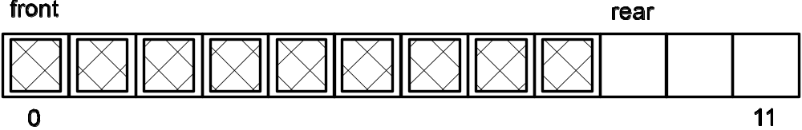
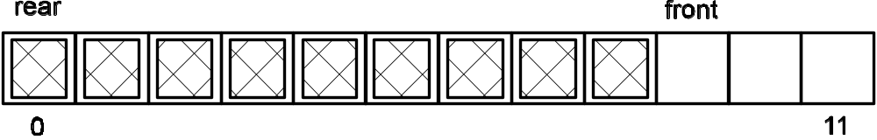
ArrayQueue: Using an Array underlying data structure
A Queue is a linear structure that is accessed at both ends.
How do we map front and rear to the two ends of an array?
Queue.front is always at 0 – shift elements left on dequeue().
(b) Queue.rear is always at 0 – shift elements right on enqueue().
7-<number>

Slide 20
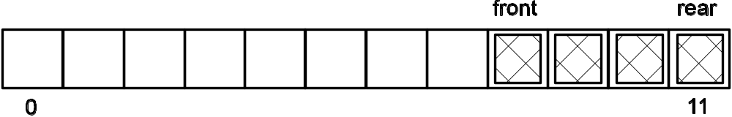
ArrayQueue: Using an Array underlying data structure
Neither of these solutions is satisfactory as they both involve moving data elements, which is expensive
Idea: Instead of moving data elements to a fixed position
for front, let front advance through the array.
Hmmm….what do we do when front catches up with rear?
7-<number>

Slide 21
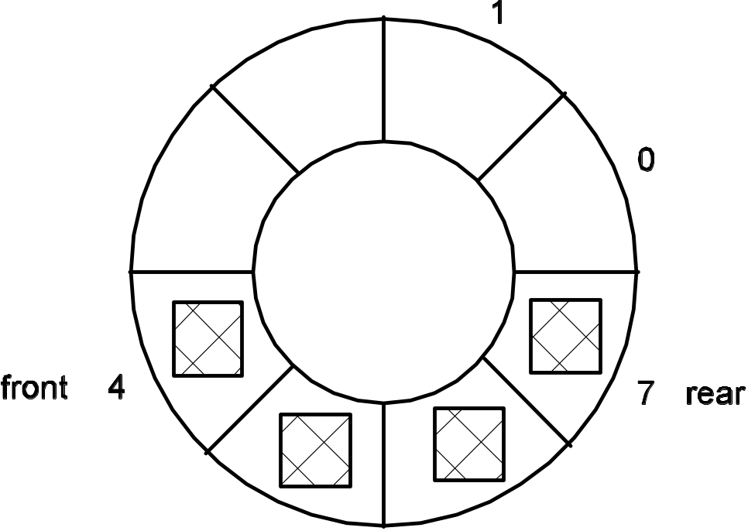
ArrayQueue: Using an Array underlying data structure
Solution: Be more creative!
View the array as circular and allow both front and rear to advance through (around) the array.
This will require no data movement for enqueues or dequeues!
7-<number>

Slide 22
An Array Implementation of Queue
Task List:
Map Queue ADT attributes to a circular array implementation.
Implement the Queue ADT operations as methods.
7-<number>

Slide 23
Queue attributes for array implementation
public class ArrayQueue<E> implements Queue<E> {
private E[] queue;
private int capacity;
private int size;
private int front;
private int rear;
This is the easy part.
Harder: to what should front and rear be initialized and
how should they be updated?
This is important because the implementation of a number of operations will depend on the answer
7-<number>

Slide 24
Initializing Queue Attributes
rear – where the next element will be inserted. Initially the queue is empty, so start rear at 0
front – trickier because the specification says it has a “null” value when the queue is empty.
  Using -1would complicate the code
  We can rely on a test for empty to check for size == 0
  This frees us to initialize front to 0 and rely on other safeguards to guarantee that front won’t be used until it is meaningful to do so (e.g., the queue isn’t empty)
7-<number>

Slide 25
Updating Queue Attributes
It is really important to think
about these details. Many hours
of debugging can be avoided!
front holds the index of the first element of the queue
  doing a deletion means extracting the value at position front in the array, then incrementing front with wraparound when the end of the array is reached
rear holds the index in the array where the next insertion will be made
  do the insertion, then increment rear (with the wraparound), so that it is ready for the next enqueue() operation
7-<number>

Slide 26
What does the implementation look like?
/**
* Insert element at the rear of the queue.
* @param element the element to be inserted
* post element is placed at the rear of the queue
* size is incremented by 1
* rear is position where the next element will be inserted
* @throws FullQueueException if isFull() is true
*/
public void enqueue( E element ) throws FullQueueException{
1. if the queue is full throw a FullQueueException
if ( this.isFull() )
throw new FullQueueException();
2. put element at the rear of the queue
this.queue[rear] = element;
3. advance rear with wraparound
this.rear = (this.rear + 1 ) % this.capacity;
4. increment size by 1
this.size++;
}
pseudocode
7-<number>

Slide 27
What does the implementation look like?
1 /**
2 * Empty the queue of elements.
3 */
4 public void clear() {
5 // empty the queue, making all the array cells null
6 while ( !this.isEmpty() )
7 this.dequeue();
8 // loop post-condition: this.size is 0
9
10 this.front = 0;
11 this.rear = 0;
12 }
We own a method to remove
elements – use it!
Remember, this is what we said
an empty queue looks like! All
methods must be consistent with
one another!
7-<number>

Slide 28
Testing the Implementations
Test cases were developed based on the API
Additional test cases should be generated to ensure that the wraparound feature works properly
  Insert elements up to capacity
  Remove some elements
  Insert additional elements forcing front and rear to wraparound
  Check that these additional elements were inserted in the correct spot and are available when they reach the front
7-<number>

Slide 29
Implementation Evaluation
ListQueue Operation | List Operation | Cost
enqueue( element ) | add( size(), element ) | Ο(1)
dequeue() | remove( 0 ) | Ο(1)
peek() | get( 0 ) | Ο(1)
clear() | clear() | Ο(1)
ArrayQueue Operation | Cost
enqueue( element ) | Ο(1)
dequeue() | Ο(1)
peek() | Ο(1)
clear() | Ο(n)
The cost of ListQueue
operations
The cost of ArrayQueue
operations
7-<number>

